Slide 1
VISHNU A
FINAL PROJECT CLOUD COMPUTING

Slide 2
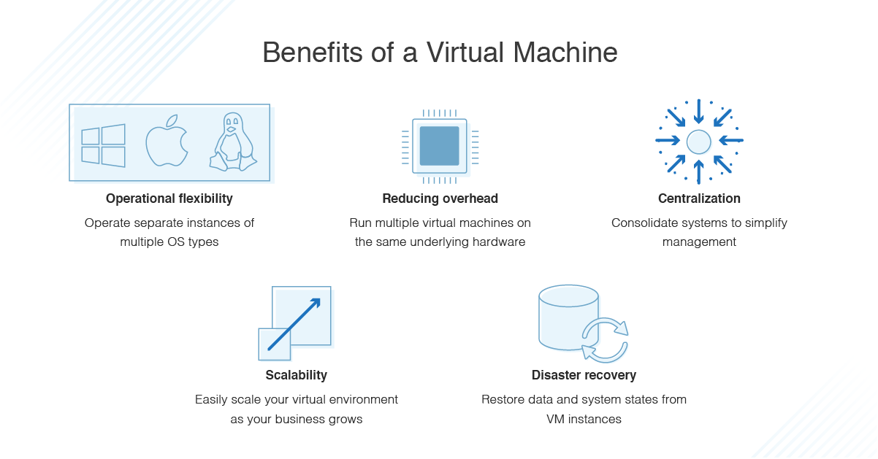
PROJECT TITLE
Creating a virtual machine on the cloud and adding extra HDD in the virtual machine

Slide 3
AGENDA
Agenda for creating a virtual machine on the cloud and adding extra HDD in the virtual machine:
Choose a cloud provider: There are several cloud providers available such as Amazon Web Services (AWS), Microsoft Azure, Google Cloud Platform, and more. Choose the one that best fits your needs.
Choose a virtualization platform: Some common virtualization platforms include VMware, Hyper-V, and VirtualBox. Choose the one that is compatible with your cloud provider.
Create a virtual machine: Once you have chosen your cloud provider and virtualization platform, create a virtual machine. The process will vary depending on the platform you choose.
Configure the virtual machine: Once the virtual machine is created, configure it by choosing the operating system and other settings.
Connect to the virtual machine: Connect to the virtual machine using remote desktop or SSH.
Add extra HDD: To add extra HDD, you will need to go to the virtual machine settings and add a new hard drive. This process will also vary depending on the virtualization platform you choose.
Initialize the extra HDD: Once the extra HDD is added, initialize it by formatting and assigning a drive letter or mount point.
Configure the extra HDD: Configure the extra HDD by assigning it a file system and other settings.
Test the extra HDD: Test the extra HDD by writing and reading files to ensure it is functioning properly.
Use the extra HDD: Now that the extra HDD is added and configured, you can use it for storing data or running applications as needed.

Slide 4
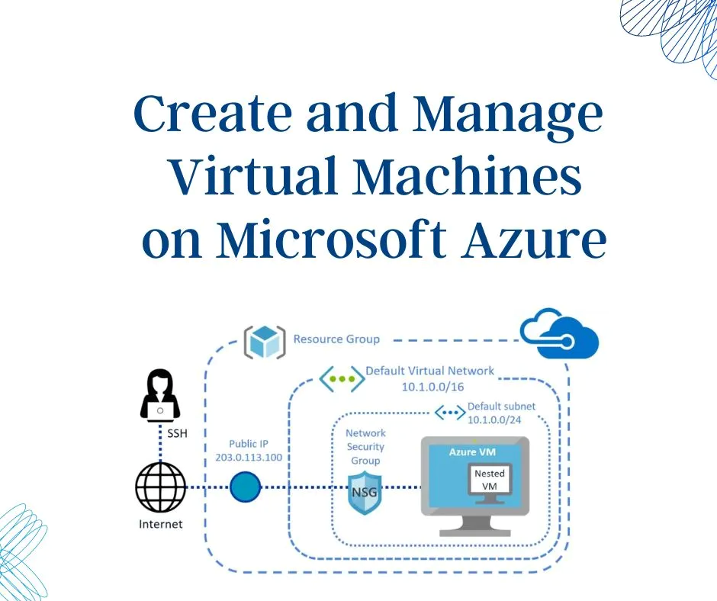
PROBLEM STATEMENT
Creating a Virtual machine (Windows OS) with the help of the Microsoft azure

Slide 5
PROJECT OVERVIEW
Overview of the steps you can follow to create a virtual machine (Windows OS) with the help of the Microsoft Azure project:
Sign in to the Azure portal: Sign in to the Azure portal using your Microsoft account credentials. If you do not have an account, you can create a free one.
Create a resource group: A resource group is a logical container for resources in Azure. Create a new resource group for your virtual machine.
Create a virtual machine: From the Azure portal, select "Create a resource" and search for "Virtual machine." Follow the wizard to create a new virtual machine.
Choose the OS image: In the "Basics" tab of the virtual machine creation wizard, choose the Windows OS image that you want to use. You can also choose the edition and version.
Choose the VM size: In the "Size" tab of the wizard, choose the virtual machine size that best fits your needs. You can also choose the number of cores, RAM, and storage.
Configure networking: In the "Networking" tab of the wizard, choose the virtual network and subnet that you want to use for your virtual machine. You can also choose the public IP address and network security group settings.
Configure storage: In the "Disks" tab of the wizard, choose the storage account and disk settings for your virtual machine. You can also choose to add data disks if needed.
Review and create: Review the settings for your virtual machine and click "Create" to start the deployment process.
Connect to the virtual machine: Once the deployment is complete, you can connect to your virtual machine using Remote Desktop Protocol (RDP).
Customize the virtual machine: Install any required software and configure the virtual machine as needed for your use case.

Slide 6
WHO ARE THE END USERS?
Developers: Developers may use virtual machines to build, test, and deploy applications in a Windows environment.
IT professionals: IT professionals may use virtual machines to host enterprise applications or perform administrative tasks on a Windows server.
Data analysts: Data analysts may use virtual machines to run analysis software and perform data processing tasks in a Windows environment.
Students and educators: Students and educators may use virtual machines to access Windows-specific software and tools for learning and teaching purposes.
Businesses: Businesses may use virtual machines to host custom applications or to run Windows-based software in a cloud environment.
Overall, anyone who needs to run a Windows OS in a virtual environment can potentially be an end user for a virtual machine created with Microsoft Azure.
Overall, anyone who needs to run a Windows OS in a virtual environment can potentially be an end user for a virtual machine created with Microsoft Azure.

Slide 7
YOUR SOLUTION AND ITS VALUE PROPOSITION
The main value proposition of creating a virtual machine with Microsoft Azure is the flexibility, scalability, and reliability of cloud-based infrastructure. By creating a virtual machine on the cloud, you can take advantage of the following benefits:
Cost savings: Creating a virtual machine on the cloud can be more cost-effective than purchasing and maintaining physical hardware.
Scalability: Cloud-based virtual machines can be easily scaled up or down as needed to meet changing business requirements.
Reliability: Cloud-based virtual machines are typically hosted in data centers with redundant power and network connectivity, providing high levels of uptime and reliability.
Security: Microsoft Azure provides robust security features such as firewalls, encryption, and access controls to help protect virtual machines from threats.
Easy deployment: The Azure portal provides a user-friendly interface for deploying and managing virtual machines, making it easy to get up and running quickly.
Compatibility: Azure provides a range of pre-configured Windows images and virtual machine sizes to meet a variety of business needs, ensuring compatibility with existing applications and software.
Overall, creating a virtual machine with Microsoft Azure can provide a flexible and cost-effective way to run a Windows OS in a cloud environment, with the added benefits of scalability, reliability, and security.

Slide 8
THE WOW IN YOUR SOLUTION
High Availability: Microsoft Azure offers robust failover and redundancy features that make virtual machines highly available, ensuring that critical workloads can continue to operate even in the event of a hardware or software failure.
Customization: With a virtual machine on Azure, you can customize the virtual machine size, storage, and networking resources to meet your specific requirements.
Easy Deployment: The Azure portal provides a user-friendly interface for deploying and managing virtual machines, making it easy to get up and running quickly.
Scalability: Virtual machines on Azure can easily scale up or down based on changing business needs, providing flexibility and cost savings.
Hybrid Connectivity: Azure provides a range of hybrid connectivity options, enabling seamless integration between your on-premises infrastructure and your cloud-based virtual machines.
Security: Microsoft Azure provides advanced security features such as firewalls, encryption, and access controls to help protect virtual machines from threats.

Slide 9
MODELLING
Creating a virtual machine (VM) on Microsoft Azure can be thought of as a form of computer modeling. In this case, the VM serves as a digital representation of a physical machine, with virtual hardware components that can be customized to meet specific needs.
The process of creating a VM involves defining the virtual hardware components, such as the CPU, RAM, and storage, and then installing an operating system, such as Windows, on the VM. This process can be done through the Azure portal or through automation tools such as PowerShell or Azure CLI.
Once the VM is created, it can be used to model a wide range of scenarios, such as testing new software, running custom applications, or deploying a web server. The VM can also be scaled up or down based on changing business needs, providing flexibility and cost savings.
Overall, creating a VM on Microsoft Azure involves modeling a digital representation of a physical machine that can be customized and scaled to meet specific needs. This digital model provides a flexible and scalable infrastructure that can be used to support a wide range of workloads.

Slide 10
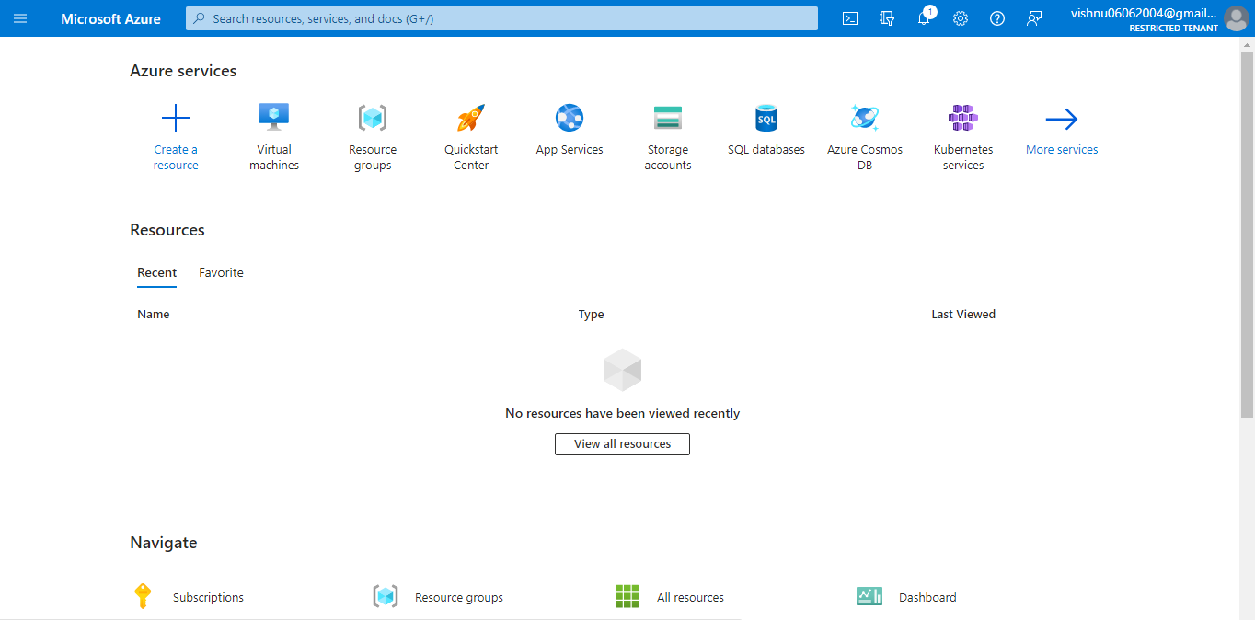

Slide 11
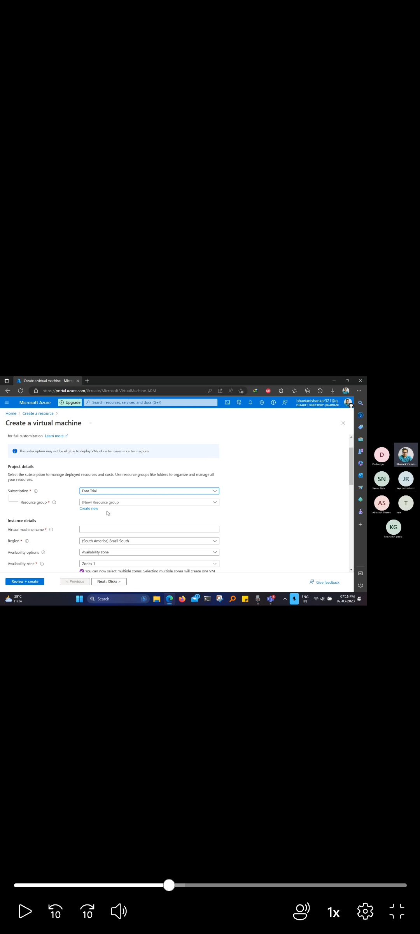

Slide 12
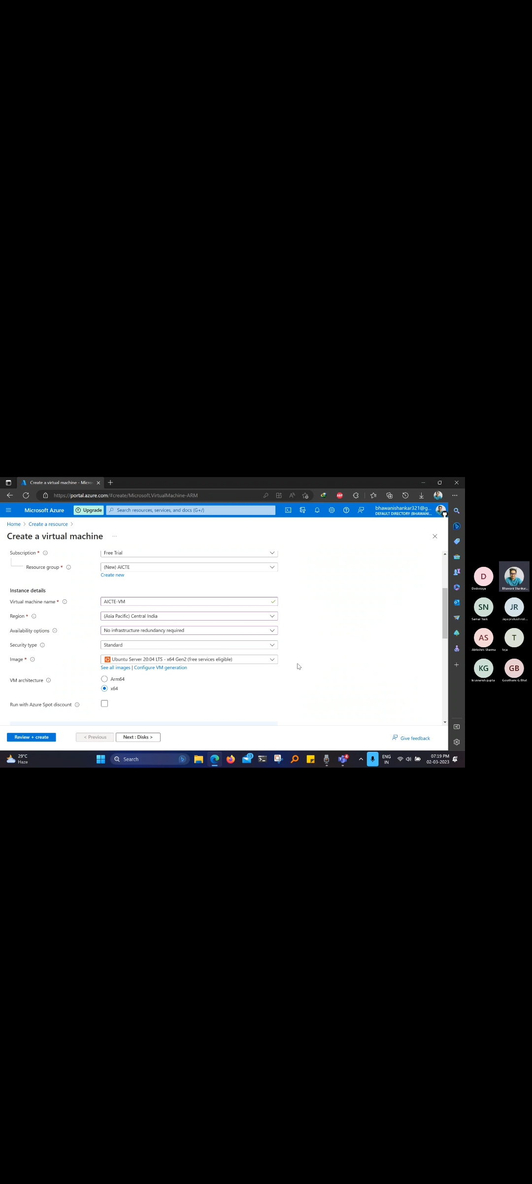

Slide 13


Slide 14


Slide 15


Slide 16


Slide 17


Slide 18


Slide 19
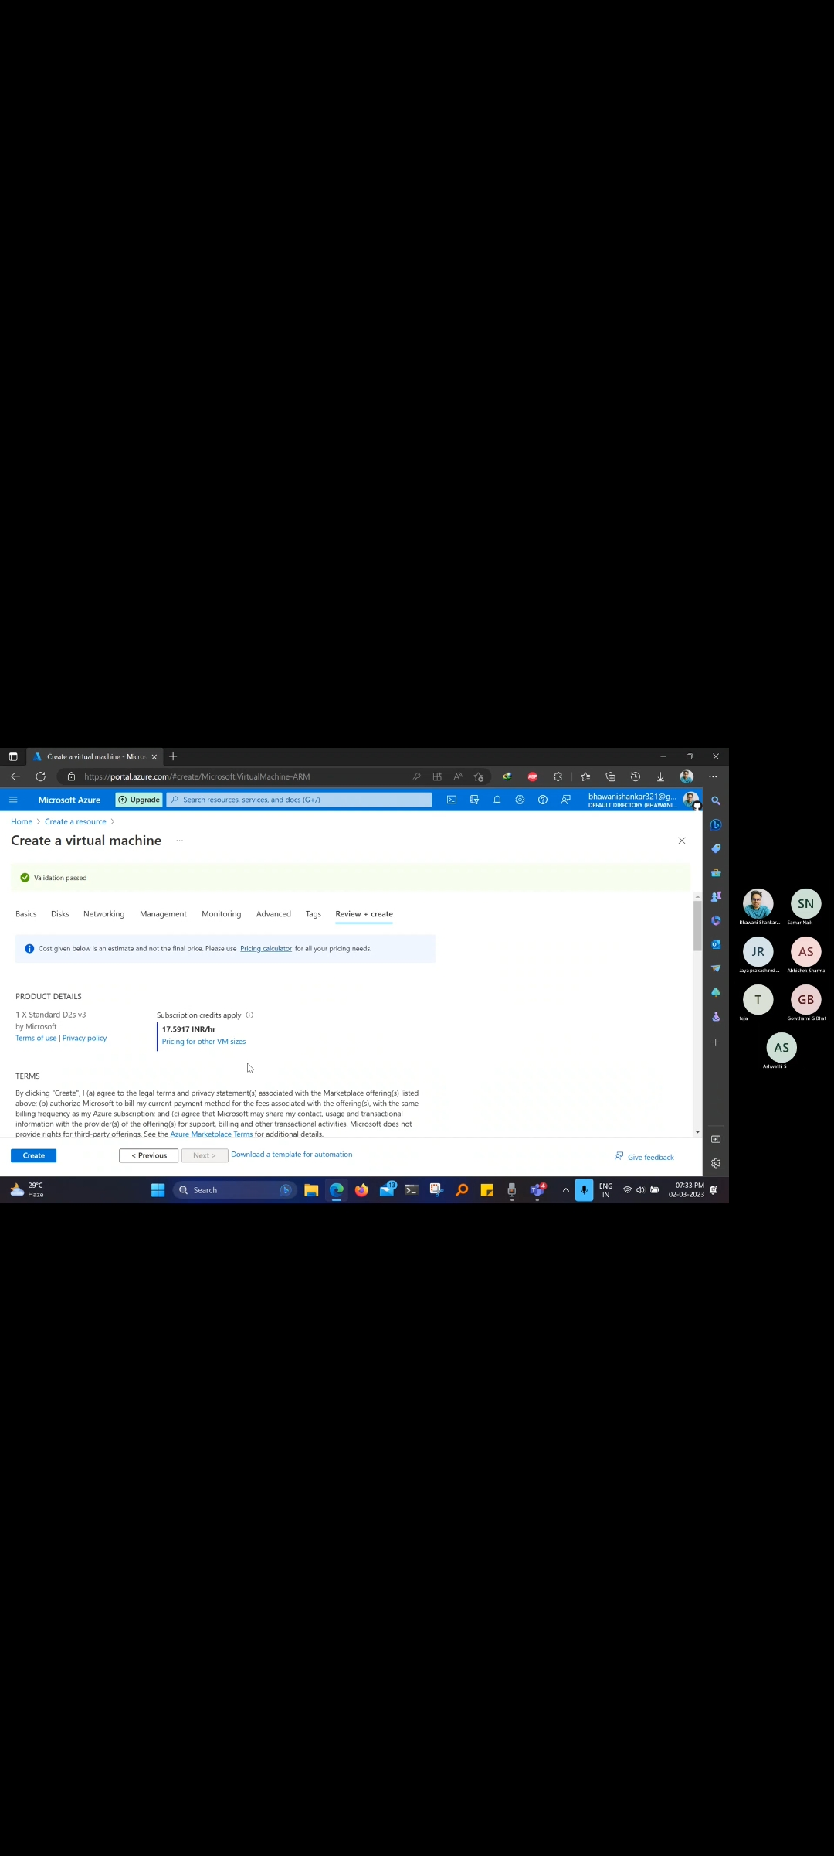

Slide 20
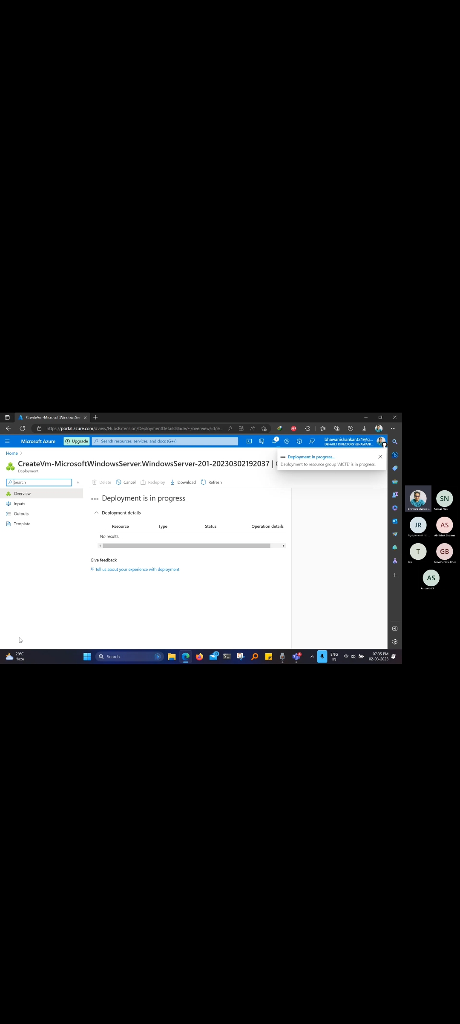

Slide 21
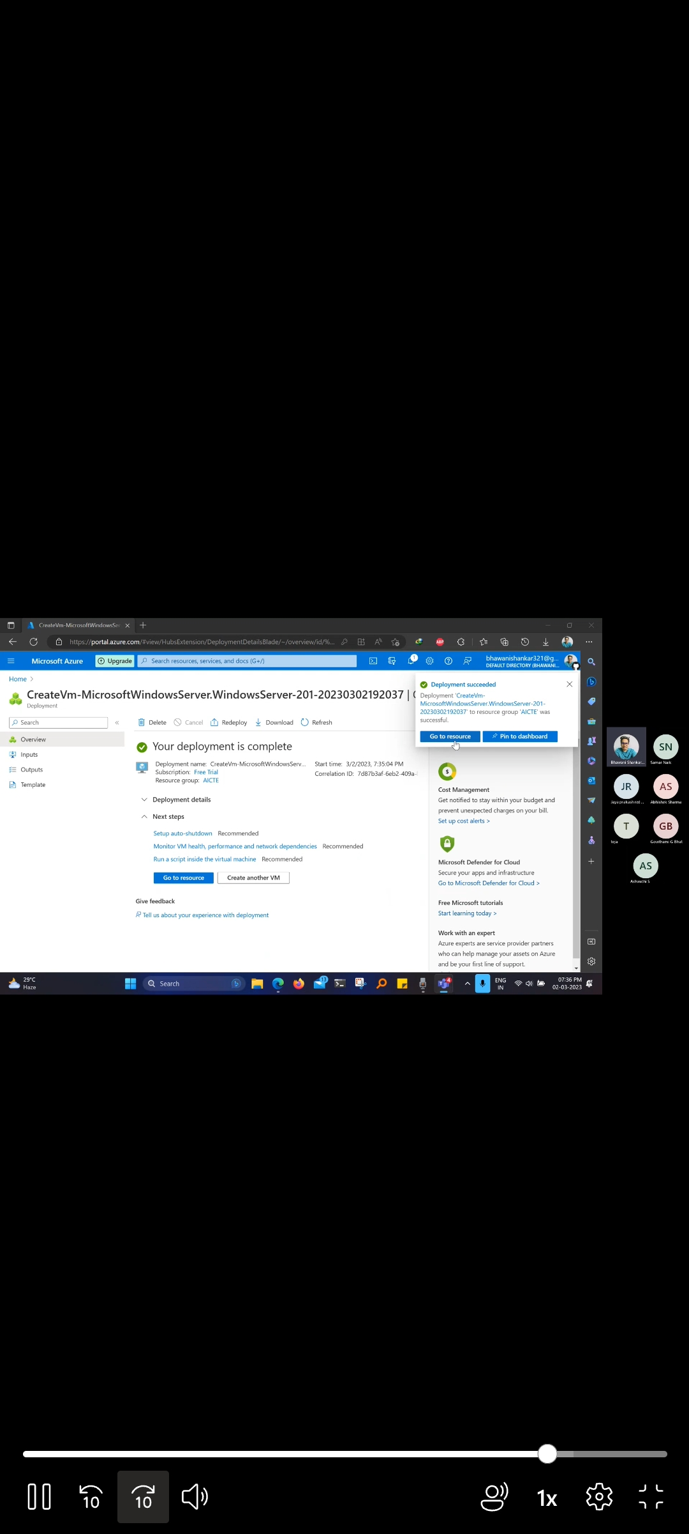

Slide 22
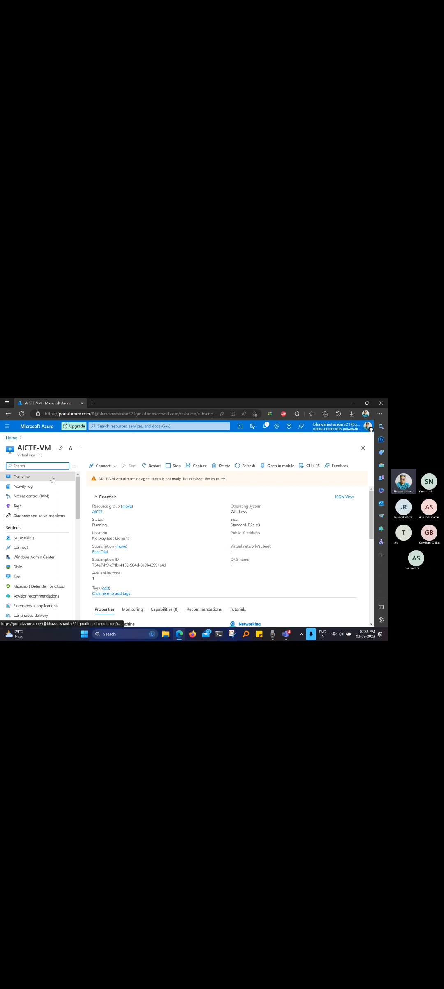

Slide 23
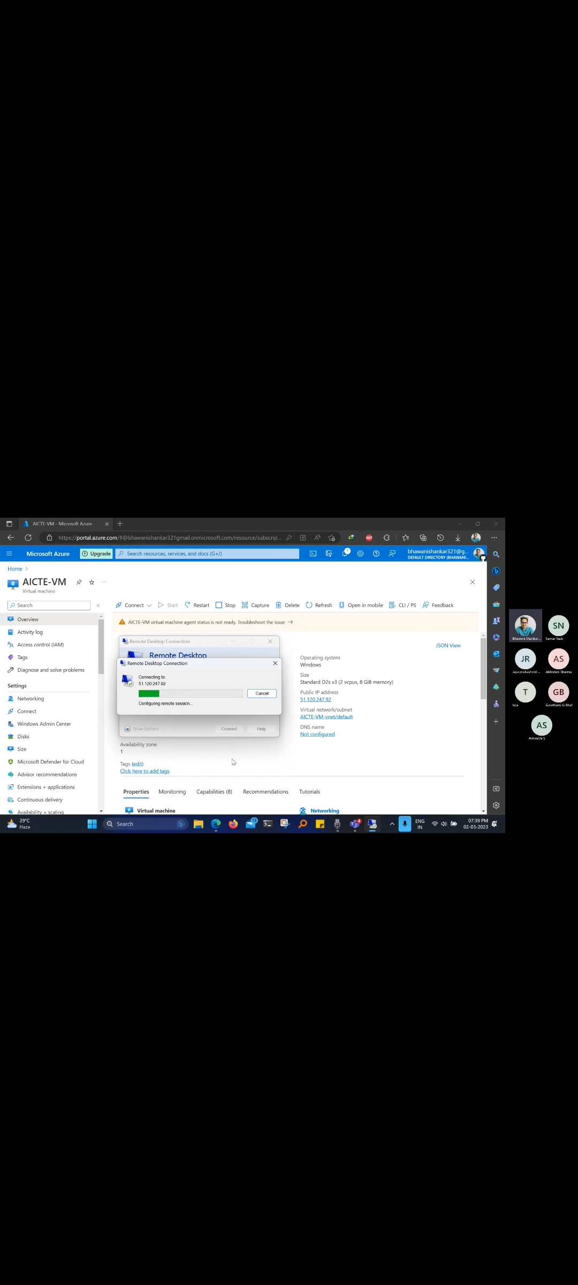

Slide 24
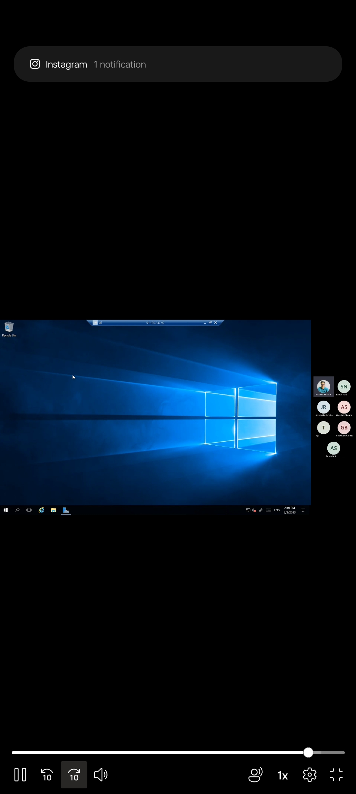

Slide 25
CONCLUSION
In conclusion, creating a virtual machine (VM) on Microsoft Azure is a powerful tool that can provide a flexible and scalable infrastructure for a variety of workloads. The process of creating a VM involves modeling a digital representation of a physical machine, with virtual hardware components that can be customized to meet specific needs.
With Microsoft Azure, creating a VM is a streamlined process that can be done through the Azure portal or through automation tools such as PowerShell or Azure CLI. Once the VM is created, it can be used to run a wide range of applications and services, and can be scaled up or down based on changing business needs.
Overall, creating a virtual machine on Microsoft Azure provides a flexible and powerful infrastructure that can support a wide range of use cases, making it a valuable tool for businesses, developers, data analysts, and others who need to run a Windows OS in a virtual environment.

Slide 26
THANK YOU

